Slide 1


Bank Personal loan
Group Members :
Pankaj
Yukti
Sunil
Jeevan
Professor :
Babatunde Giwa

Slide 2


Real Life problem we trying to solve ? The classification goal is to predict the likelihood of a liability customer buying personal loans.
Algorithms used :
Logistic Regression
Naïve Bayes
KNN

Slide 3
Libraries Used
Pandas
NumPy
Seaborn
Matplotlib
sklearn
SciPy

Slide 4

Data Attributes
ID: Customer ID
Age: Customer's age in completed years
Experience: #years of professional experience
Income: Annual income of the customer ($000)
ZIP Code: Home Address ZIP code.
Family: Family size of the customer
CCAvg : Avg. spending on credit cards per month ($000)
Education: Education Level. 1: Undergrad; 2: Graduate; 3: Advanced/Professional
Mortgage: Value of house mortgage if any. ($000)
Personal Loan: Did this customer accept the personal loan offered in the last campaign?
Securities Account: Does the customer have a securities account with the bank?
CD Account: Does the customer have a certificate of deposit (CD)account with the bank?
Online: Does the customer use internet banking facilities?
Credit card: Does the customer use a credit card issued by Universal Bank?

Slide 5

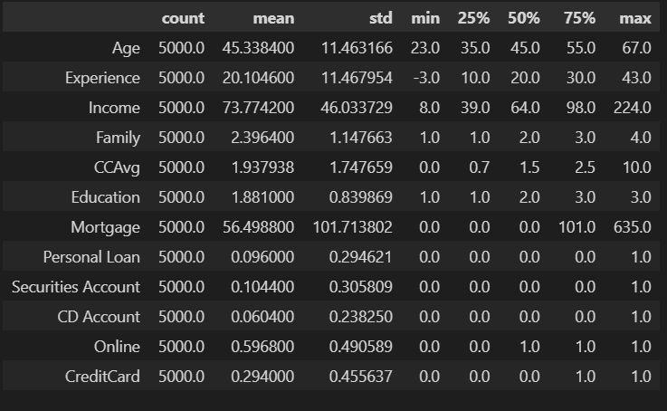

Exploratory Data Analysis(EDA)
Shape
Is null
Unique
Describe
It can be observed that the experience is negative which is not possible, so we replace the experience by its absolute values

Slide 6
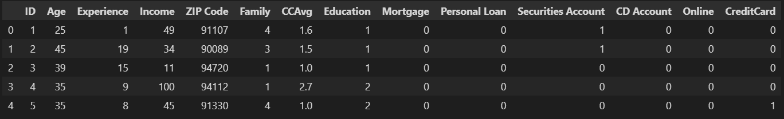
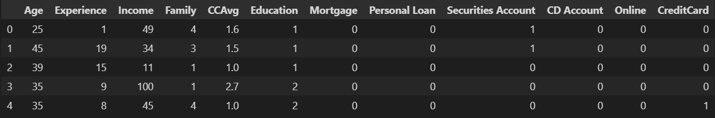
Relevant variables
Since there is no relation of Personal Loan with ID and ZIP code, we can drop it

Slide 7
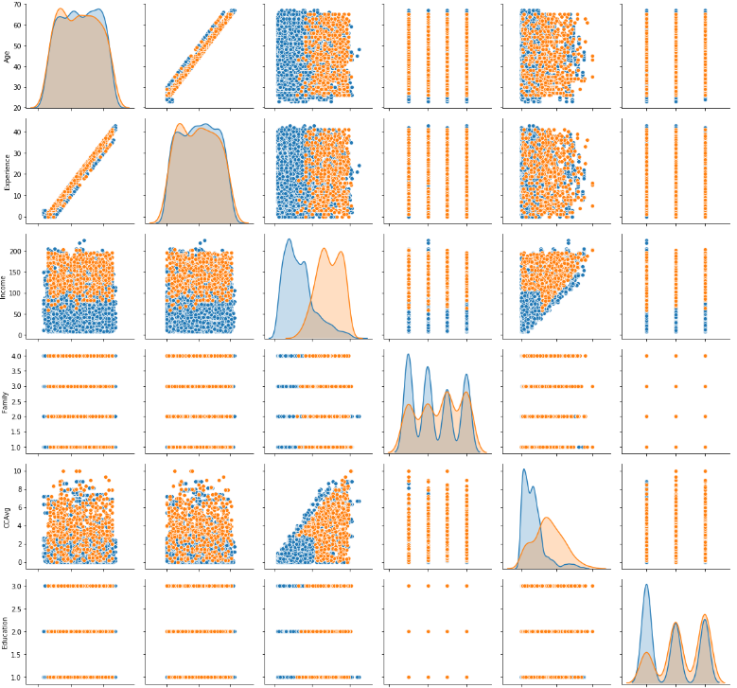


Pair Plot map
Observation
It is used to understand the best set of features to explain a relationship between two variables or to form the most separated clusters

Slide 8
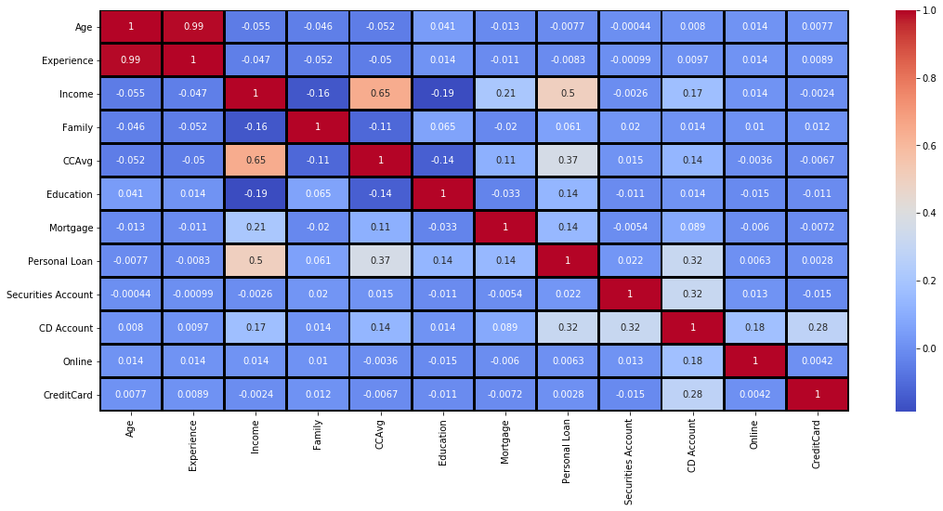
Correlation MAP : It can be seen from the pairplot and heatmap that Age and Experience are highly correlated Personal loan is related to (Income, CCAvg, Mortgage, CD Account)

Slide 9

DATA VISUALIZATION
It is a statistical hypothesis test used in the analysis of contingency tables when the sample sizes are large.

Slide 10
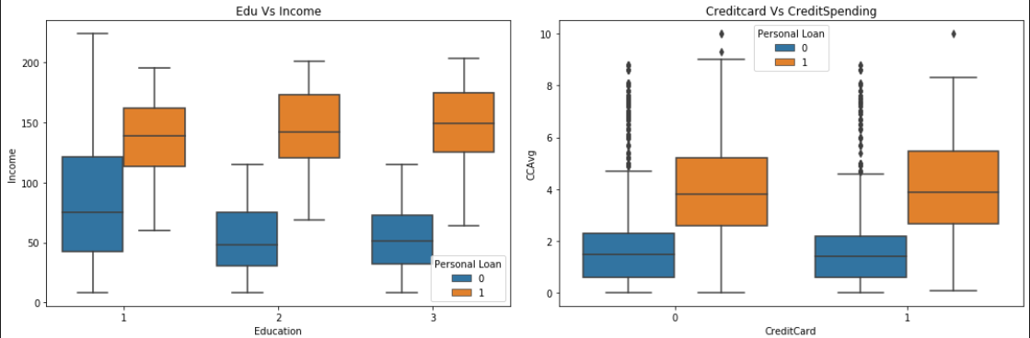
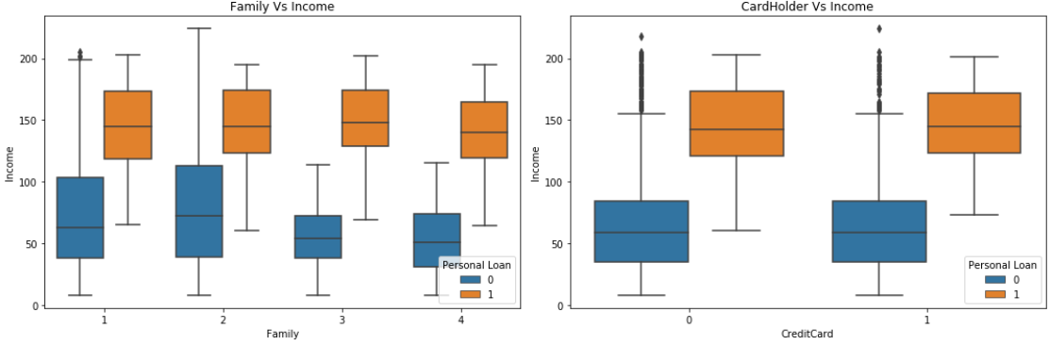
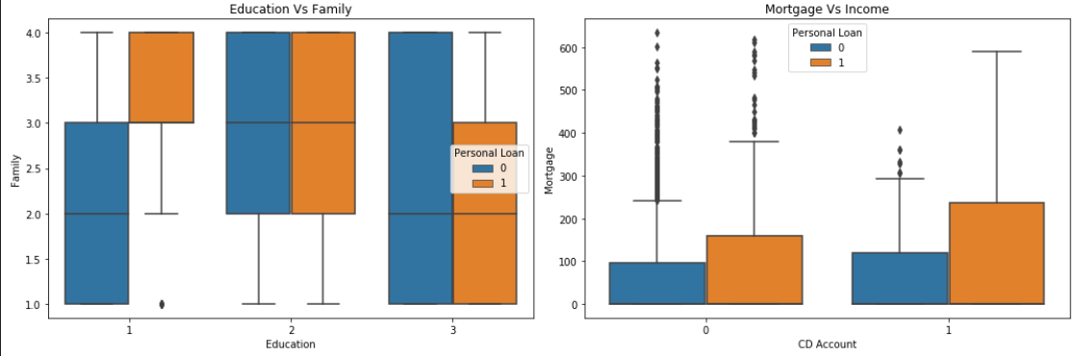
Box plot
It shows that undergraduate people with family size> 3 are good targets Graduate and post graduate are good targets irrespective of family size Customers with CDAccount and have taken mortgage also are potential targets

Slide 11
CHI SQUARE ANALYSIS
It is a statistical hypothesis test used in the analysis of contingency tables when the sample sizes are large.
H0: is personal loan has no relationship with incoming variable
Ha: is personal loan is dependent on the incoming variable

Slide 12
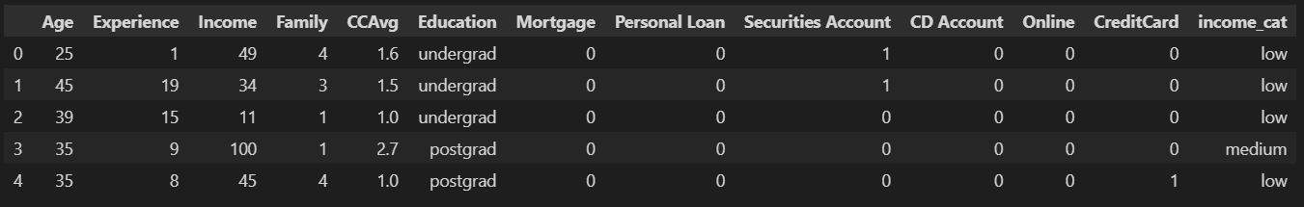
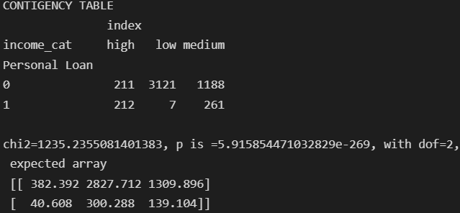
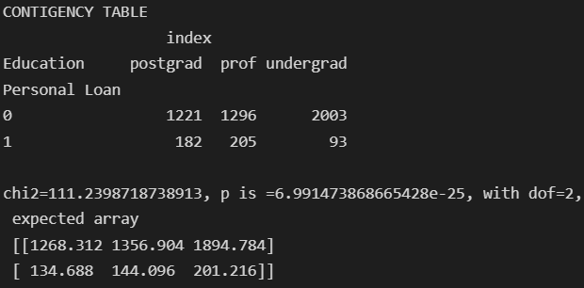
Contingency Table
SINCE P value is <<0.001 we reject the null hypothesis and conclude that personal loan is dependent on Education

Slide 13
Model Building Analysis

Slide 14
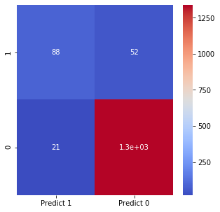
Model Building .Logistic Regression
True Positive (TP): our model is correctly predicting 88 from testing data
True Negative (TN): our model correctly predicts that 1339 will not take loan
False Positive (FP): our model is incorrectly predicting that they will take loan (Type 1 error) 21
False Negative (FN): our model is incorrectly predicting that they will not take loan (Type 2 error) 52

Slide 15
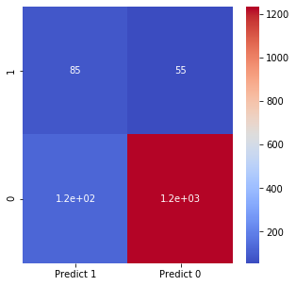
Naïve Bayes
True Positive (TP): our model is correctly predicting 85 from testing data
True Negative (TN): our model correctly predicts that 1235 will not take loan
False Positive (FP): our model is incorrectly predicting that they will take loan (Type 1 error) 125
False Negative (FN): our model is incorrectly predicting that they will not take loan (Type 2 error) 55

Slide 16
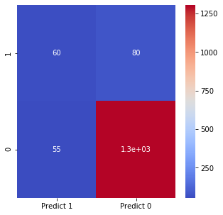
KNN
True Positive (TP): our model is correctly predicting 60 from testing data
True Negative (TN): our model correctly predicts that 1305 will not take loan
False Positive (FP): our model is incorrectly predicting that they will take loan (Type 1 error) 55
False Negative (FN): our model is incorrectly predicting that they will not take loan (Type 2 error) 80

Slide 17
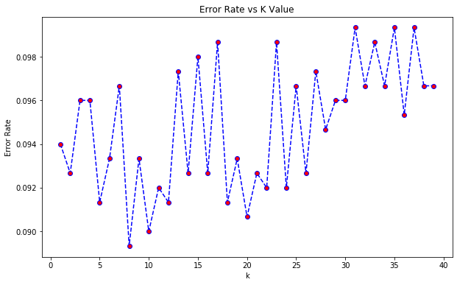
Error Rate vs K-Values

Slide 18
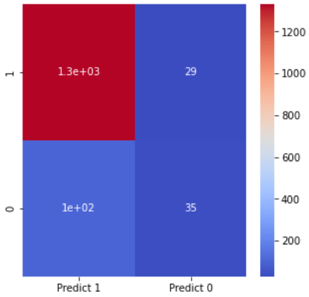
KNN (with k=8)
True Positive (TP): our model is correctly predicting 1300 from testing data
True Negative (TN): our model correctly predicts that 35 will not take loan
False Positive (FP): our model is incorrectly predicting that they will take loan (Type 1 error) 100
False Negative (FN): our model is incorrectly predicting that they will not take loan (Type 2 error) 29

Slide 19
Conclusion: Model Scores
Logistic Regression | Naïve Bayes | KNN (with K=5 & K=8)
0.95133 | 0.8834 | 0.91
Logistic Regression is giving us the best result with 95% accuracy, as the Type 1 and Type 2
error is minimum in this case.

